Slide 1
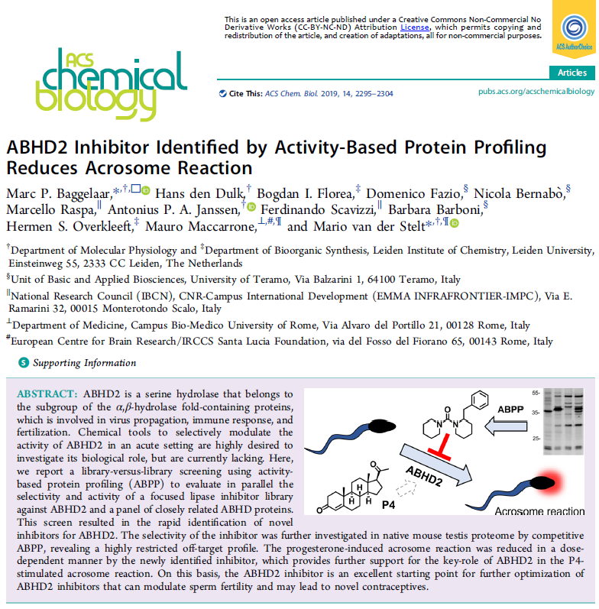
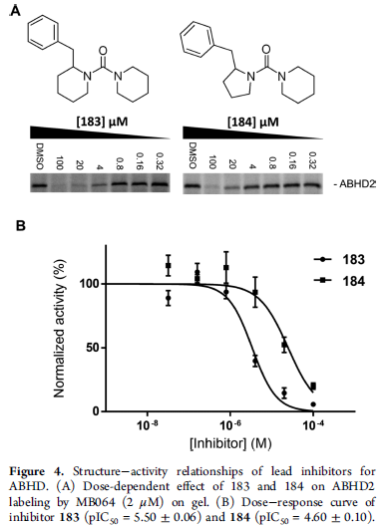
Identification of ABHD2i
LE 0.36
ClogP 3.3

Slide 2

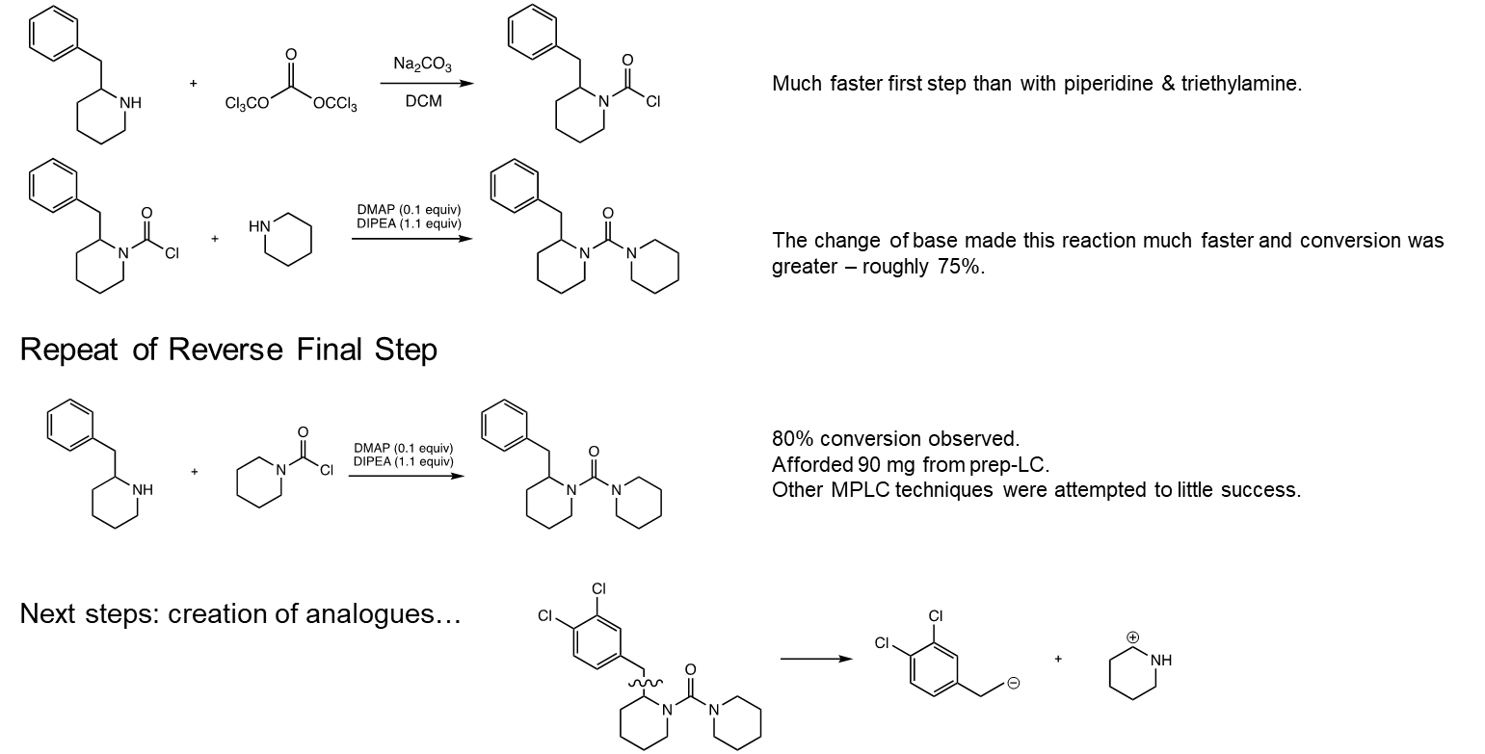
ABHD2i synthesis (Kirsty Bentley)

Slide 3

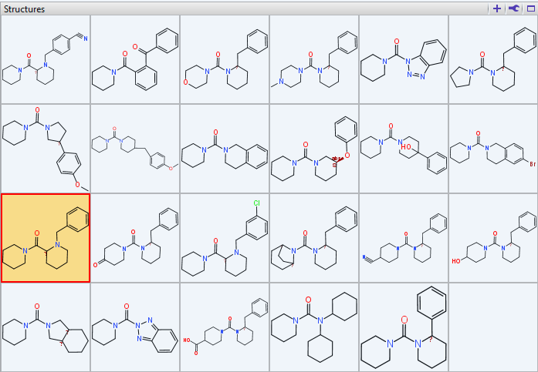
Analogues made by Pauline Ribera

Slide 4
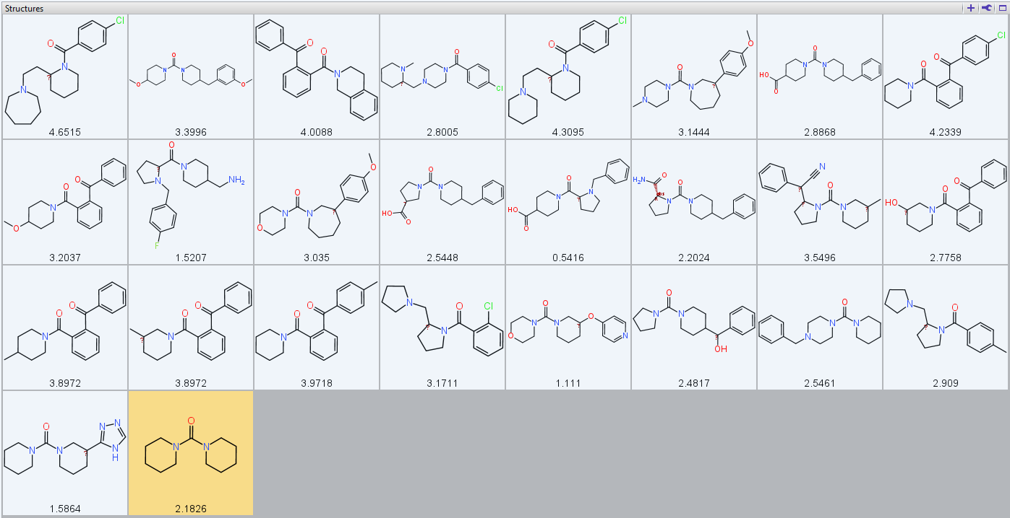
Analogues selected by Eve Carter

Slide 5
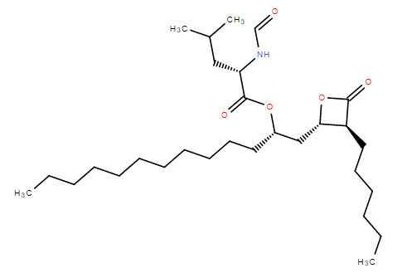
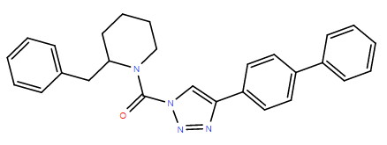
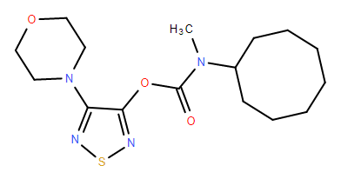
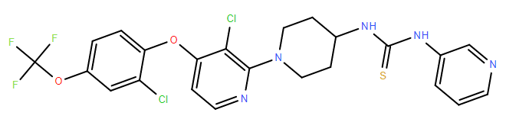
Additional ABHD inhibitors ordered
Orlistat
(ABHD6: 7.85)
KT109
(ABHD6: 7.8)
JZP 430
(ABHD6: 7.06)
DO264
(ABHD12: 7.96)

Slide 6
Backup slides

Slide 7
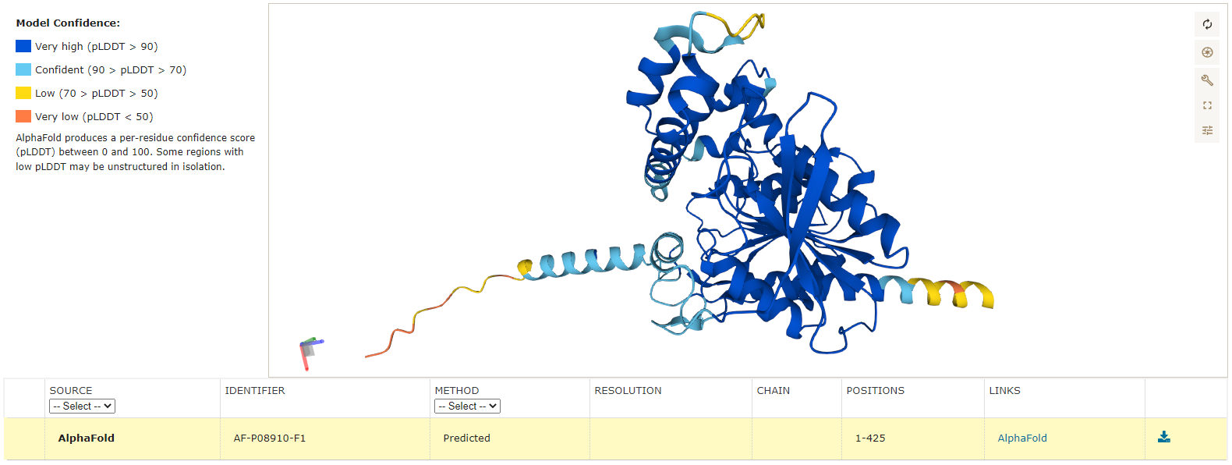
Human ABHD2 – AlphaFold model

Slide 8
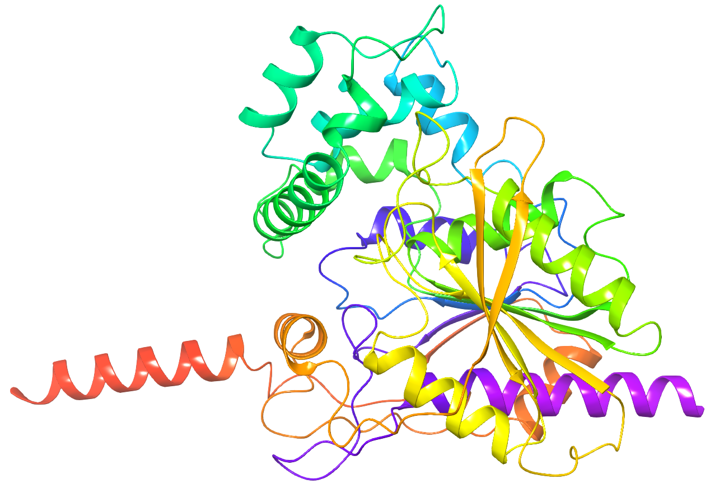
Human ABHD2 – AlphaFold model
N-term 14
C-term 414

Slide 9
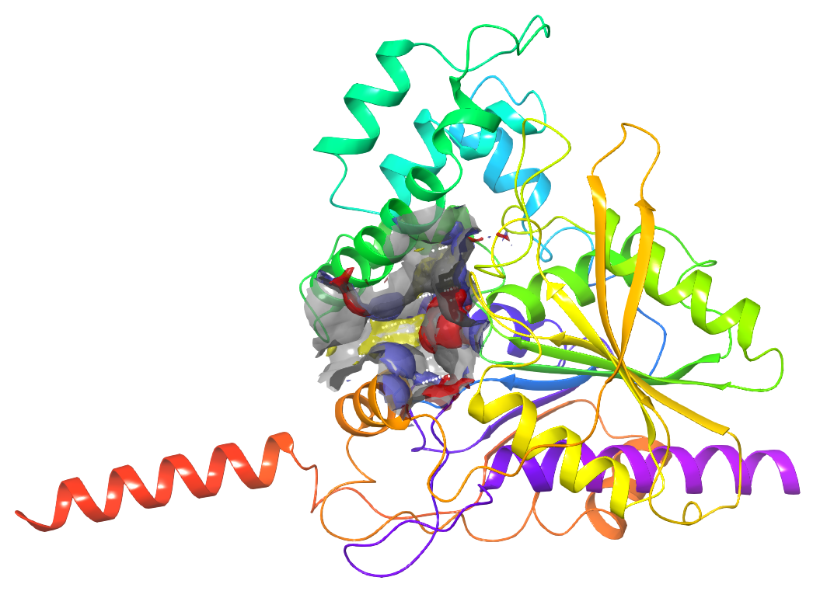
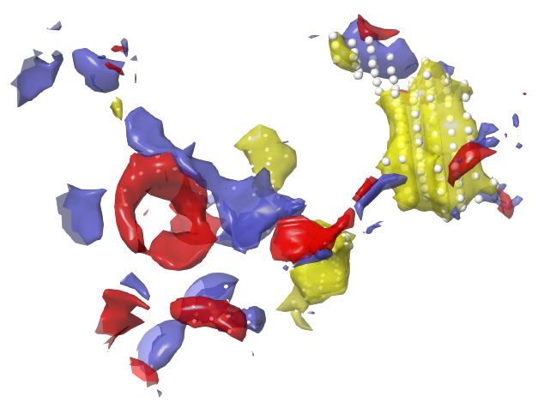
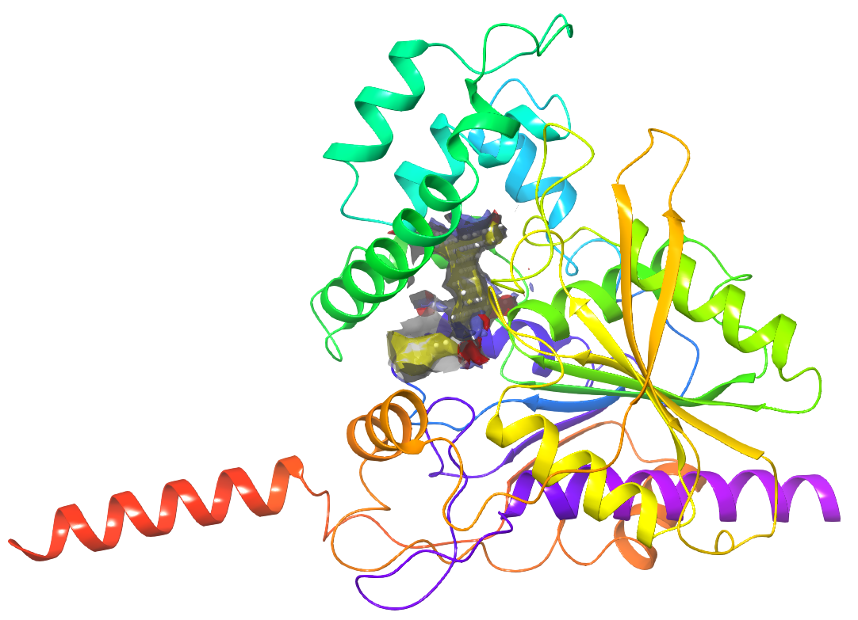
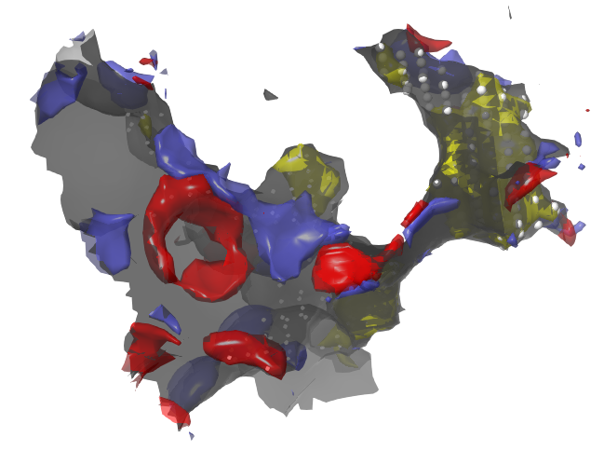
ABHD2 AF Model harbours 2 lipophilic sites connected through narrow channel
2
1
2
1
Site 1
Dscore: 1.05
Phob/phil balance: 1.09
Site 2
Dscore: 1.34
Phob/phil balance: 5.89

Slide 10
ABDH2 Natural substrates & ligands
1-Arachidonoylglycerol (1AG)
Progesterone
Urea 1
pIC50: 5.5
Baggelaar et al. ACS Chem. Biol. 2019, 14, 2943
2-Arachidonoylglycerol (2AG)

Slide 11
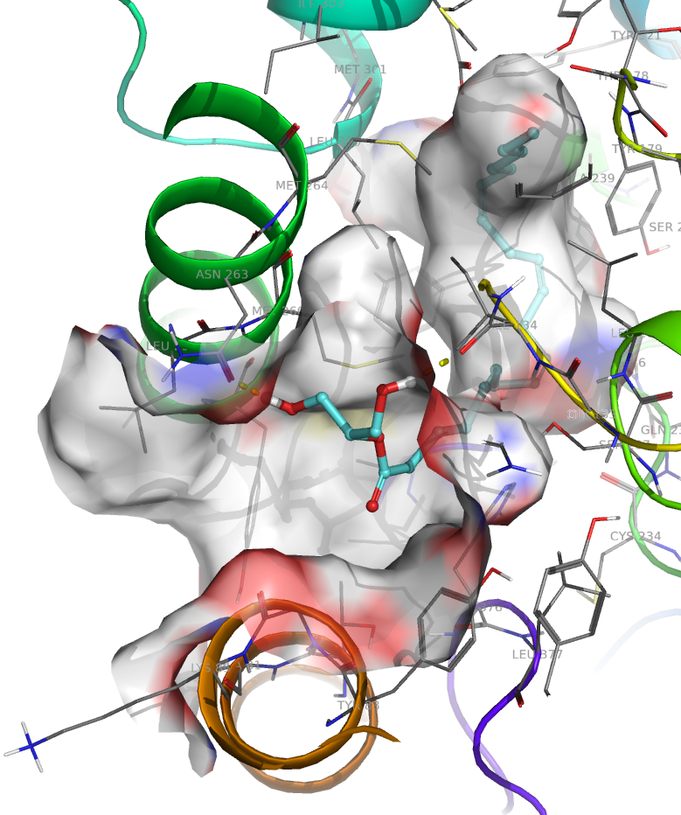
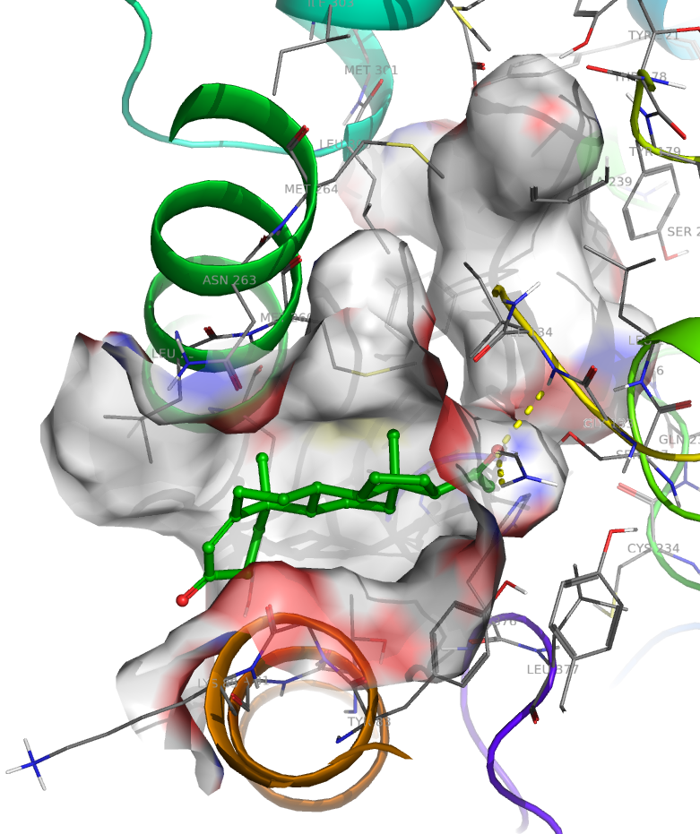
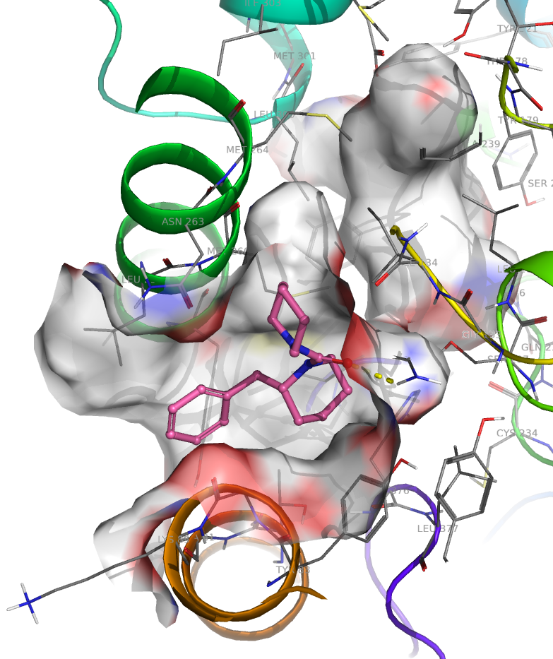
2AG, progesterone & Urea_1 docked to
merged sites 1 & 2 using Glide SP

